Slide 1
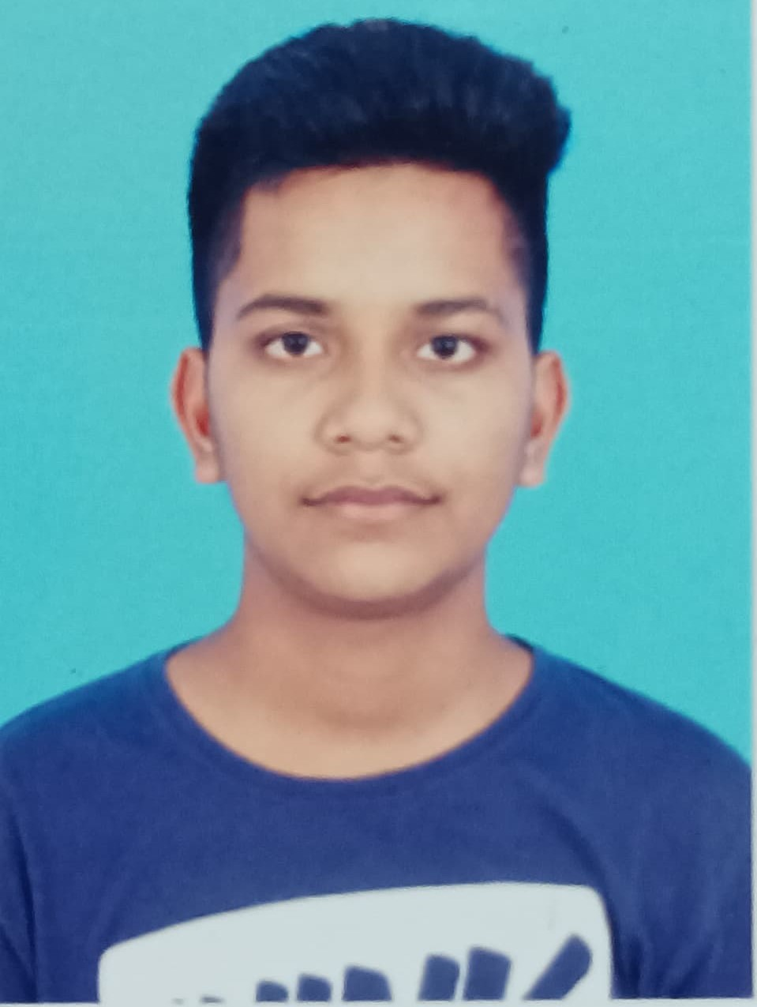
Student Details
Name: Gorantla Sravan Kumar
Skillbuild Email ID: gorantlasravankumar2003@gmail.com
College Name: Avanthi Institute of Engineering and Technology
College State: Andhra Pradesh
Intership Domain: ARTIFICAL INTELLIGENCE & MACHINE LEARNING
Intership Start and End Date: 21st February 2024 to 20th March 2024

Slide 2
TRAFFIC PREDICTION USING MACHINE LEARNING

Slide 3
Problem Statement
The problem at hand is to develop a predictive model that accurately forecasts traffic levels on roads at various times of the day and days of the week. The prediction of traffic levels is crucial for urban planning, transportation management, and optimizing resource allocation.

Slide 4
Features
Date and Time Features
Weather Conditions
Traffic Volume Features
Road Network Characteristics
Public Transportation Data
Accident and Incident Data
Real-Time Data Sources

Slide 5
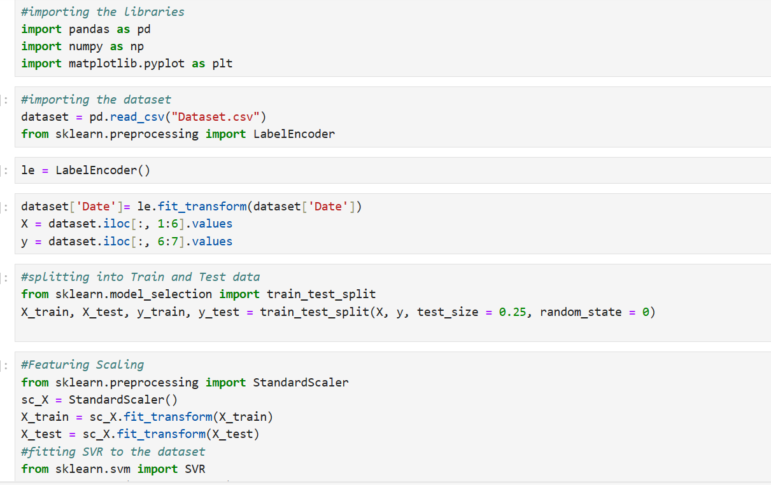
SVM Regression

Slide 6
LINKS
Github:
https://github.com/Sravan2206/INTERNSHIPS/tree/main/IBM%202

Slide 7
THANK YOU

